Slide 1
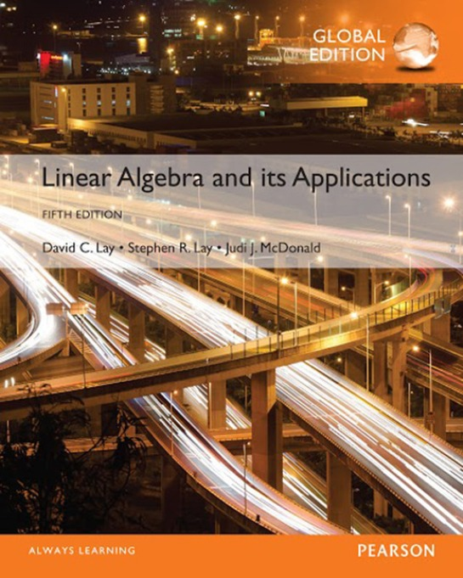
Linear Equations in Linear Algebra
LINEAR MODELS IN BUSINESS, SCIENCE, AND ENGINEERING

Slide 2
LINEAR EQUATIONS AND ELECTRICAL NETWORKS
Current flow in a simple electrical network can be described by a system of linear equations.
A voltage source such as a battery forces a current of electrons to flow through the network. When the current passes through a resistor some of the voltage is “used up”; by Ohm’s law, this “voltage drop” across a resistor is given by
V = RI
Where the voltage V is measured in volts, the resistance R in ohms (denoted by Ω), and the current flow I in amperes (amps, for short).

Slide 3
LINEAR EQUATIONS AND ELECTRICAL NETWORKS
Kirchhoff’s Voltage Law: The algebraic sum of RI voltage drops in one direction around a loop equals the algebraic sum of the voltage sources in the same direction around the loop.
Example 2 Determine the loop currents in the network in Fig.1
Solution For loop 1, the current I1 flows through three resistors, and the sum of the RI voltage drops is
4I₁ + 4I₁ + 3I₁ = (4 + 4 + 3)I₁= 11I₁

Slide 4
LINEAR EQUATIONS AND ELECTRICAL NETWORKS

Slide 5
LINEAR EQUATIONS AND ELECTRICAL NETWORKS
Current from loop 2 also flows in part of loop 1, through the short branch between A and B. The associated RI drop there is 3I₂ volts. However, the current direction for the branch AB in loop 1 is opposite to that chosen for the flow in loop 2, so the algebraic sum of all RI drops for loop 1 is 11I₁ – 3I₂ .
Since the voltage in loop 1 is +30 volts, Kirchhoff's voltage law implies that
11I₁ – 3I₂ = 30
The equation for loop 2 is
-3I₁ + 6I₂ – I₃= 5

Slide 6
LINEAR EQUATIONS AND ELECTRICAL NETWORKS
The term -3I₁ comes from the flow of the loop-1 current through the branch AB (with a negative voltage drop because the current flow there is opposite to the flow in loop 2).
The term 6I₂ is the sum of all resistances in loop 2, multiplied by the loop current.
The term –I₃ = -1·I₃ comes from the loop-3 current flowing through the 1-ohm resistor in branch DC, in the direction opposite to the flow in loop 2. The loop-3 equation is
-I₂ + 3I₃= -25

Slide 7
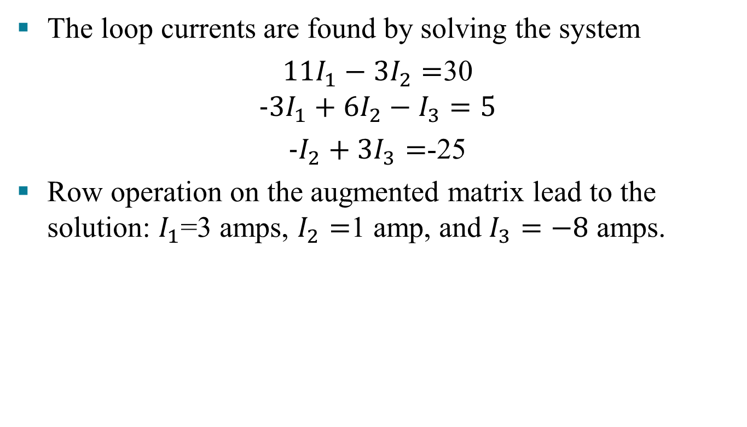
LINEAR EQUATIONS AND ELECTRICAL NETWORKS
The loop currents are found by solving the system
$11I_{1}−3I_{2}=$30
$$-3I_{1}+6I_{2}−I_{3}=5$$
$-I_{2}+3I_{3}=$-25
Row operation on the augmented matrix lead to the solution: $I_{1}$=3 amps, $I_{2}=$1 amp, and $I_{3}=−8$ amps.

Slide 8
LINEAR EQUATIONS AND ELECTRICAL NETWORKS
It is instructive to look at system (3) as a vector equation:
The first entry of each vector concerns the first loop, and similarly for the second and third entries. The first r₁ lists the resistance in the various loops through which current I₁ flows. A resistance is written negatively when I₁ flows against the flow direction in another loop.

Slide 9
LINEAR EQUATIONS AND ELECTRICAL NETWORKS
Examine Fig. 1 and see how to compute the entries in r₁; then do the same for r₂ and r₃. The matrix form of equation (4),
Provides a matrix version of Ohm’s law. If all loop currents are chosen in the same direction (say, counterclockwise), then all entries off the main diagonal of R will be negative.

Slide 10
LINEAR EQUATIONS AND ELECTRICAL NETWORKS
The matrix equation Ri=v makes the linearity of this model easy to see at a glance. For instance, if the voltage vector is doubled, then the current vector must double.
Also, a superposition principle holds. That is, the solution of equation (4) is the sum of the solutions of the equations
Each equation here corresponds to the circuit with only one voltage source (the other sources being replaced by wires that close each loop).

Slide 11
LINEAR EQUATIONS AND ELECTRICAL NETWORKS
The model for current flow is linear precisely because Ohm’s law and Kirchhoff's law are linear:
The voltage drop across a resistor is proportional to the current flowing through it (Ohm), and the sum of the voltage drops in a loop equals the sum of the voltage sources in the loop (Kirchhoff).

Slide 12
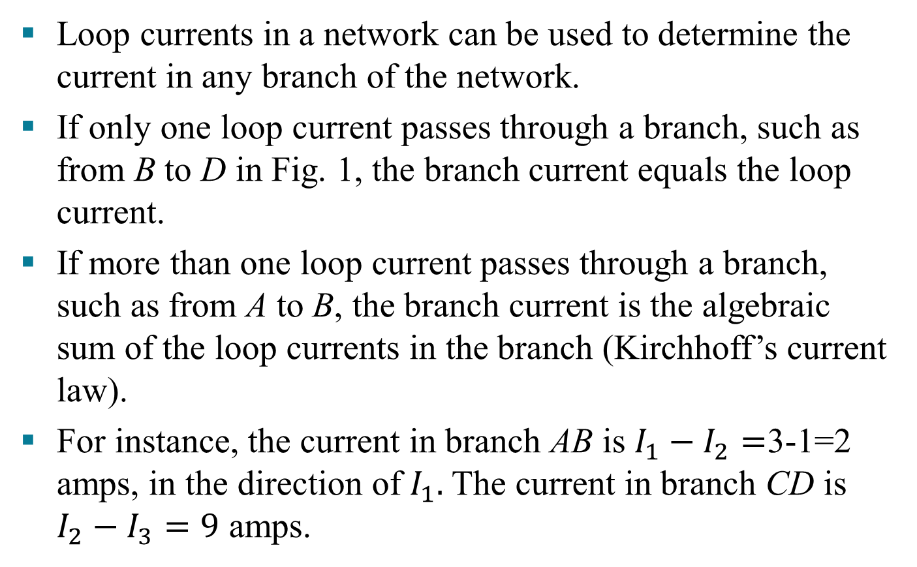
LINEAR EQUATIONS AND ELECTRICAL NETWORKS
Loop currents in a network can be used to determine the current in any branch of the network.
If only one loop current passes through a branch, such as from B to D in Fig. 1, the branch current equals the loop current.
If more than one loop current passes through a branch, such as from A to B, the branch current is the algebraic sum of the loop currents in the branch (Kirchhoff’s current law).
For instance, the current in branch AB is $I_{1}−I_{2}=$3-1=2 amps, in the direction of $I_{1}.$The current in branch CD is $I_{2}−I_{3}=9$ amps.

Slide 13
DIFFERENCE EQUATIONS
In many fields such as ecology, economics, and engineering, a need arises to model mathematically a dynamic system that changes over time.
Several features of the system are each measured at discrete time intervals, producing a sequence of vectors x_{0,} x_{1,} x_{2,} …..The entries in x_{k} provide information about the state of the system at the time of the kth measurement.
If there is a matrix A such that x₁= Ax_{0,} x₂ = Ax_{1,} and, in general
x_{k+1} = Ax_{k} for k = 0, 1, 2, . . .
then (5) is called a linear difference equation (or recurrence relation)

Slide 14
DIFFERENCE EQUATIONS
Given such an equation, one can compute x₁, x₂, and so on, provided x₀ is known.
The discussion below illustrates how a difference equation might arise.
A subject of interest to demographers is the movement of populations or groups of people from one region to another. The simple model here considers the changes in the population of a certain city and its surrounding suburbs over a period of years.

Slide 15
DIFFERENCE EQUATIONS
Fix an initial year—say, 2000—and denote the populations of the city and suburbs that year by r₀ and s₀, respectively. Let x₀ be the population vector
For 2001 and subsequent years, denote the populations of the city and suburbs by the vectors
Our goal is to describe mathematically how these vectors might be related.

Slide 16
DIFFERENCE EQUATIONS
Suppose demographic studies show that each year about 5% of the city’s population moves to the suburbs (and 95% remains in the city), while 3% of the suburban population moves to the city (and 97% remains in the suburbs). See Fig. 2 below:

Slide 17
DIFFERENCE EQUATIONS
After 1 year, the original r₀ persons in the city are now distributed between city and suburbs as
The so persons in the suburbs in 2000 are distributed 1 year later as

Slide 18
DIFFERENCE EQUATIONS
The vectors in (6) and (7) account for all of the populations in 2001. Thus
That is,
Where M is the migration matrix determined by the following table:

Slide 19
DIFFERENCE EQUATIONS
Equation (8) describes how the population changes from 2000 to 2001. If the migration percentages remain constant, then the change from 2001 to 2002 is given by
And similarly for 2002 to 2003 and subsequent years. In general,
The sequence of vectors {x₀, x₁, x₂,…} describes the population of the city/suburban region over a period of years.

